Slide 1
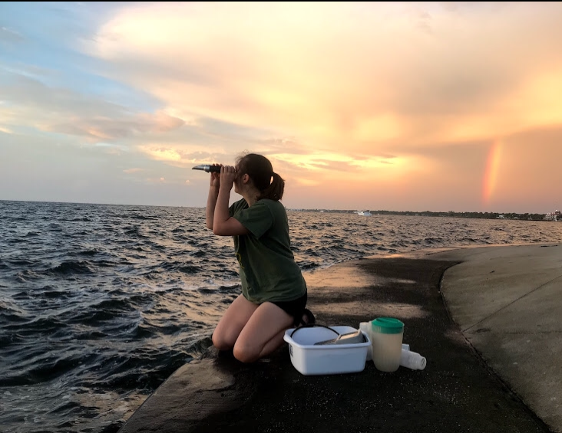
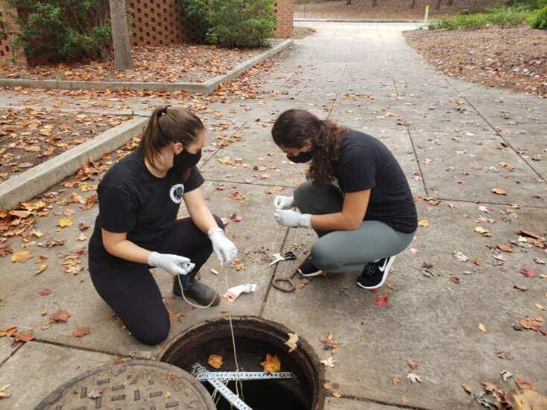
From Sea
Microbial Monitoring
in Natural and Built Environments
Megan Lott, PhD Student
Advised by Dr. Erin K. Lipp
To Sewer

Slide 2





Live
Work
Play

Slide 3
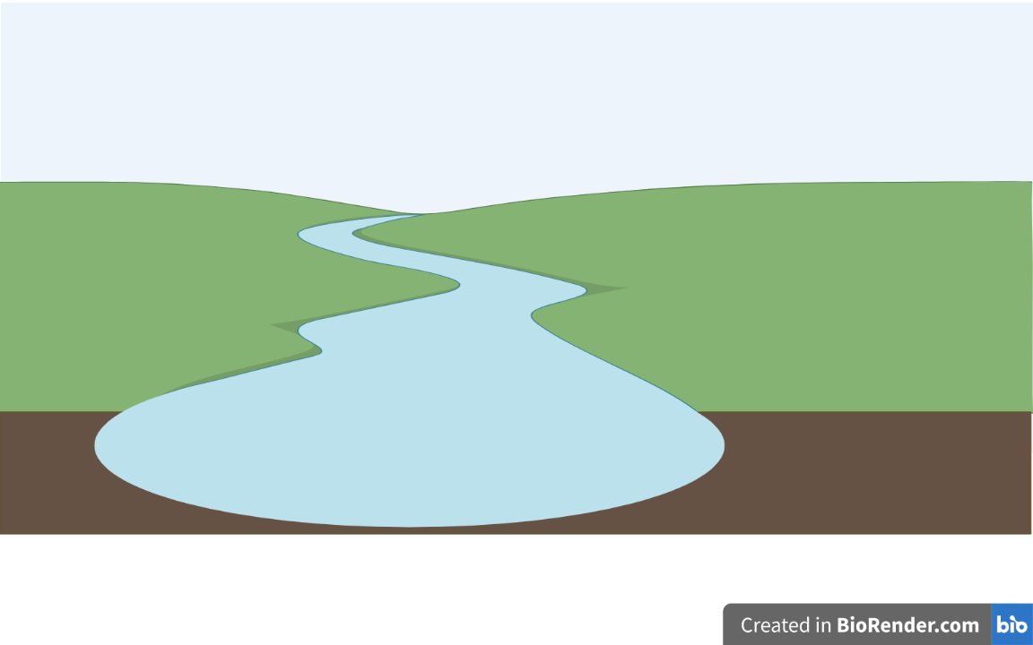


Slide 4
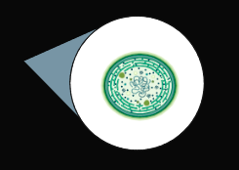

Slide 5

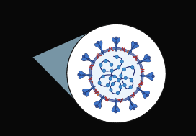

Slide 6
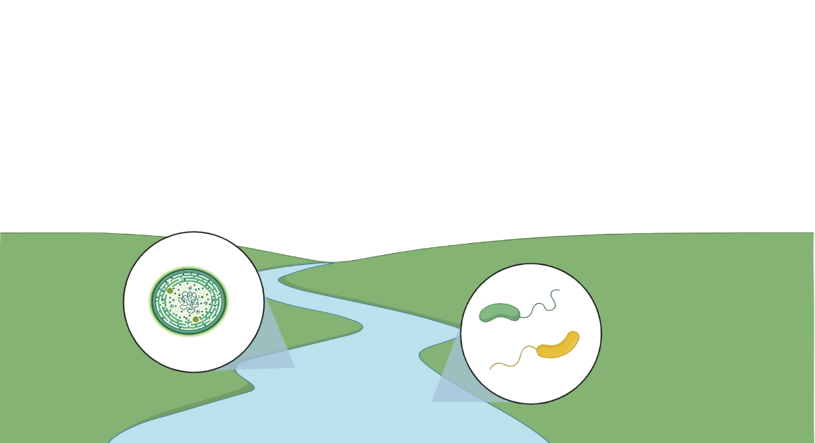
Chapter 1: Microbial Ecology of Vibrio bacteria in the Indian River Lagoon of Eastern Florida, USA
Chapter 2: Bacterial-Algal Community Dynamics in the Indian River Lagoon of Eastern Florida, USA

Slide 7

Chapter 3: Wastewater-based Surveillance for SARS-CoV-2 in Athens, Georgia, USA

Slide 8
Wastewater-based Surveillance for SARS-CoV-2 in Athens, Georgia
Megan Lott, William Norfolk, Cody Dailey,
Amelia Foley, Carolina Melendez Declet, Megan Robertson, Taylor Maddalene,
Erin K. Lipp
Notes:
Thanks so much for the introduction, Dr. Tibull! And thanks so much for inviting me to join you all today. I am quite excited to connect with you all the way from Athens, Georgia! Today, I’ll be sharing a bit about our most recent research: monitoring wastewater for SARS-CoV-2

Slide 9
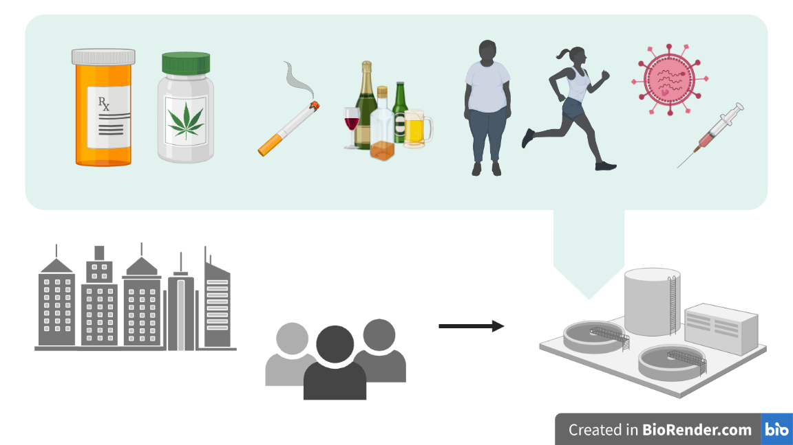
Notes:
While largely unseen, wastewater infrastructure can serve as a brilliant source of information about community health. Wastewater - collected across entire neighborhoods, towns, and cities - typically flows into a central receiving facility for wastewater reclamation. By monitoring wastewater for health indicators (i.e. metabolites, prescription and illicit drugs, or pathogens), we can capture a snapshot of our community’s health. We are provided with health data in a single sample, without the need for extensive clinical testing. In this way, our wastewater infrastructure serves as an “information highway.”

Slide 10
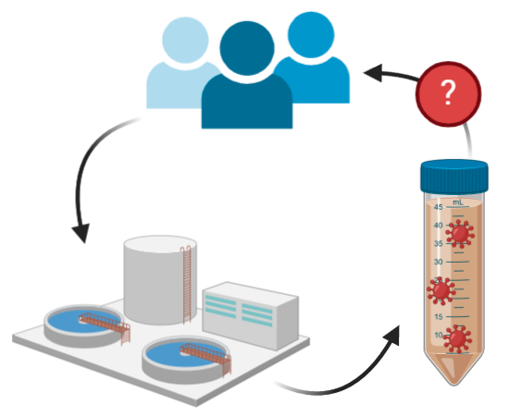
Central Question
Can the COVID-19 pandemic be monitored through wastewater surveillance for SARS-CoV-2?

Slide 11
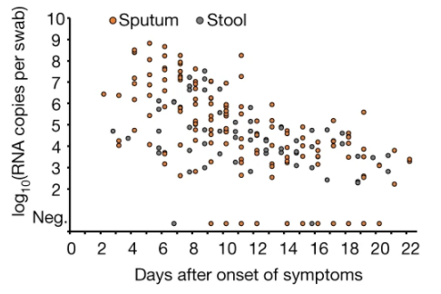
SARS-CoV-2 is shed in stools
Wölfel, R., Corman, V.M., Guggemos, W. et al. Virological assessment of hospitalized patients with COVID-2019. Nature 581, 465–469 (2020).

Slide 12
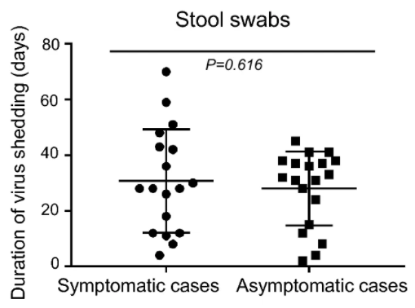
Symptomatic and asymptomatic cases shed SARS-CoV-2 in stool
Cai, J., Wang, X., Zhao, J. et al. Comparison of Clinical and Epidemiological Characteristics of Asymptomatic and Symptomatic SARS-CoV-2 Infection in Children. Virol. Sin. 35, 803–810 (2020).

Slide 13
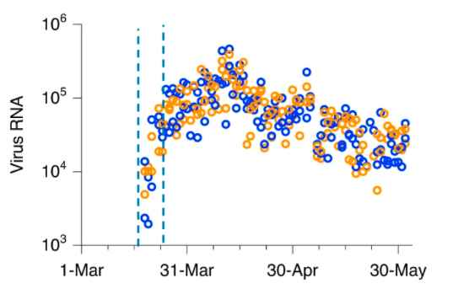
SARS-CoV-2 could be detected at water reclamation facilities.
Even early in the pandemic.
Peccia, J., Zulli, A., Brackney, D.E. et al. Measurement of SARS-CoV-2 RNA in wastewater tracks community infection dynamics. Nat Biotechnol 38, 1164–1167 (2020).
Data from Spring 2020 | New Haven, CT

Slide 14
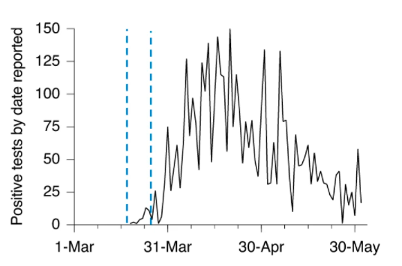
SARS-CoV-2 RNA in wastewater tracks community infection dynamics.
Peccia, J., Zulli, A., Brackney, D.E. et al. Measurement of SARS-CoV-2 RNA in wastewater tracks community infection dynamics. Nat Biotechnol 38, 1164–1167 (2020).
Data from Spring 2020 | New Haven, CT

Slide 15
SARS-CoV-2 RNA in wastewater tracks can lead cases by several days.
Peccia, J., Zulli, A., Brackney, D.E. et al. Measurement of SARS-CoV-2 RNA in wastewater tracks community infection dynamics. Nat Biotechnol 38, 1164–1167 (2020).
Data from Spring 2020 | New Haven, CT

Slide 16
Motivation
To better understand the outbreak of the novel Coronavirus disease-19 (COVID‑19) on a local level through wastewater surveillance

Slide 17
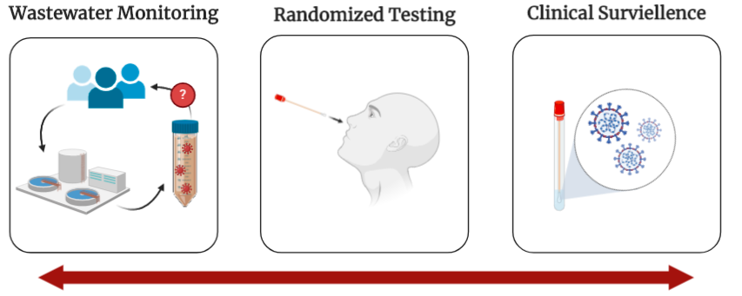
Motivation
To complement the University & County’s efforts in randomized testing and clinical surveillance to improve our understanding of the local transmission of infection

Slide 18
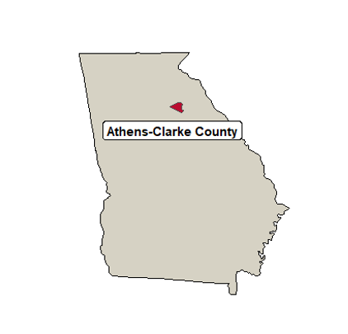


Athens-Clarke County, Georgia
Notes:
Motivation:
Description of Athens, GA
consolidated city–county and college town in the U.S. state of Georgia. Athens lies about 70 miles outside of downtown Atlanta.
College town situated in NE Georgia, home to the University of Georgia.
Perhaps a particularly vulnerable population, with the disparities in household income and health insurance coverage.
124,000 - Based on the Census Data
Population based on the number of people paying taxes?? – SES information as well!

Slide 19
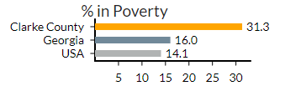
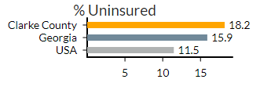
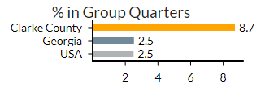
Athens-Clarke County, Georgia
Data from: Emory COVID-19 Health Equity Dashboard (COVID19.emory.edu)
Notes:
Motivation:
This is JUST full time residents. This is our concern with our full time residents.
And while we can appreciate the assets of our community, such as the mobilization of our research institutions and medical trainees, we must recognize some of the risk factors that may make Athens-Clarke County particularly vulnerable to consequences of the pandemic.
In Athens, there are notable disparities in socioeconomic status and healthcare coverage, where 30% of our residents live below the poverty level, and 20% of our community remains uninsured. A notable number of individuals live in group quarters, such as nursing homes, or multi-family units.
We may erhaps a particularly vulnerable population.

Slide 20

Student Population Flux
30,000 Undergraduate
5,000 Incoming
9,000 Graduate
Notes:
On top of the vulnerabilities of our full-time residents, our community was anxiously anticipating the return of a large population of students. Total population 40,000 students. This population events introduce more opportunities for introduction of new infections and increase opportunities,
to an already vulnerable residential population
Accurate for COVID times?

Slide 21
Research Questions
Can we apply wastewater-based surveillance for SARS-CoV-2 in Athens, GA?
Can we detect SARS-CoV-2 in wastewater with currently available methods?
How well do trends in viral loads in wastewater correlate with cases of COVID-19. Is wastewater a leading indicator to predict outbreaks?

Slide 22
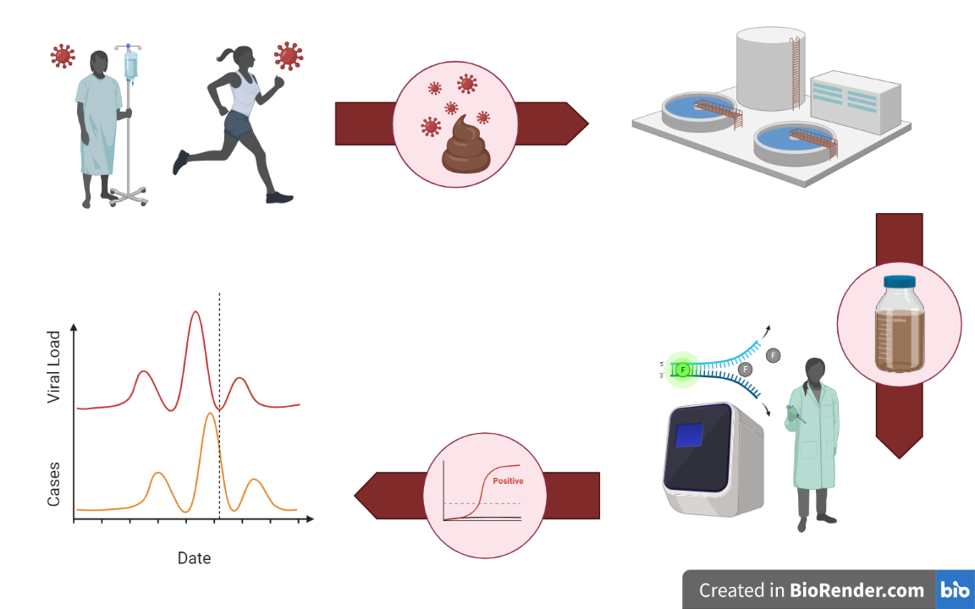
Wastewater-based Surveillance
for SARS-CoV-2

Slide 24
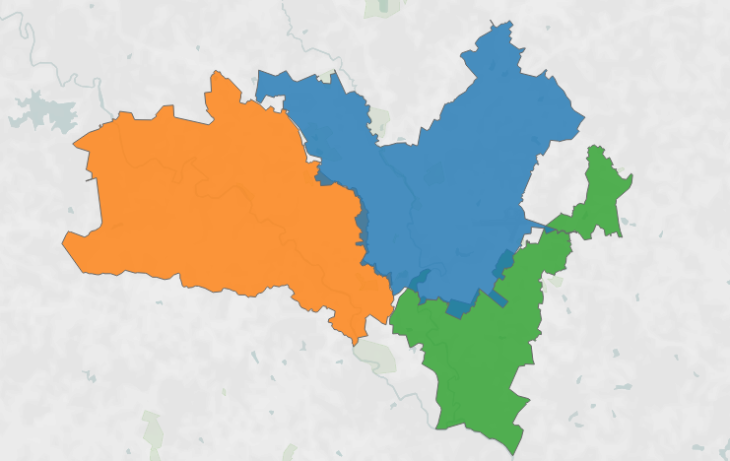
Notes:
Needs to be changed!!! Add in sewer map + emojis of the different contributions to each catchment area
+ highly residential + hospital +
Tell the story of this slide
Here is Athens.
We started by sampling three water treatment facilities in Athens.
Within each catchment area, there are different contributions that lead to different wastewater – catching different scopes of our community
Wasteater information highway

Slide 25

Catchment A
5.32 MGD
Notes:
Needs to be changed!!! Add in sewer map + emojis of the different contributions to each catchment area
+ highly residential + hospital +
Tell the story of this slide
Here is Athens.
We started by sampling three water treatment facilities in Athens.
Within each catchment area, there are different contributions that lead to different wastewater – catching different scopes of our community
Wasteater information highway

Slide 26
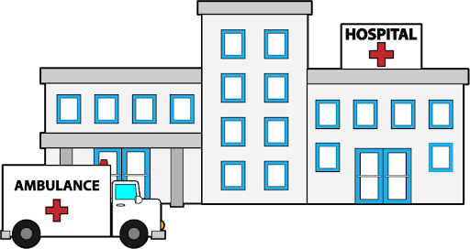
Catchment A
5.32 MGD
Catchment B
4.80 MGD
Notes:
Needs to be changed!!! Add in sewer map + emojis of the different contributions to each catchment area
+ highly residential + hospital +
Tell the story of this slide
Here is Athens.
We started by sampling three water treatment facilities in Athens.
Within each catchment area, there are different contributions that lead to different wastewater – catching different scopes of our community
Wasteater information highway

Slide 27

Catchment A
5.32 MGD
Catchment B
4.80 MGD
Catchment C
1.99 MGD
Notes:
Needs to be changed!!! Add in sewer map + emojis of the different contributions to each catchment area
+ highly residential + hospital +
Tell the story of this slide
Here is Athens.
We started by sampling three water treatment facilities in Athens.
Within each catchment area, there are different contributions that lead to different wastewater – catching different scopes of our community
Wasteater information highway

Slide 29
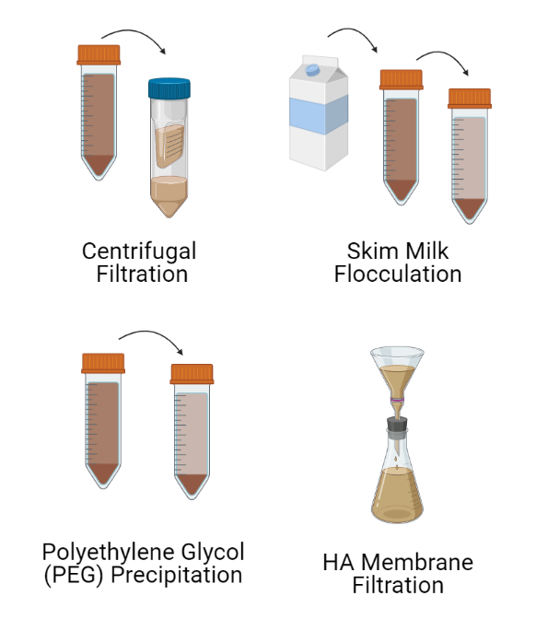
Our First Challenge:
Current concentration methods were developed for enteric, non-enveloped viruses.
SARS-CoV-2 is an enveloped respiratory virus.

Slide 30
Methods Development

Slide 31
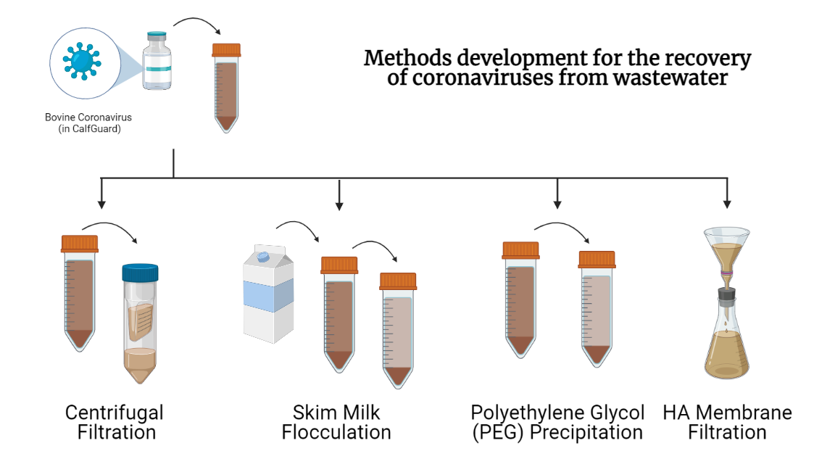

Slide 32
<1%
<1%
~8%
~10%

Slide 33
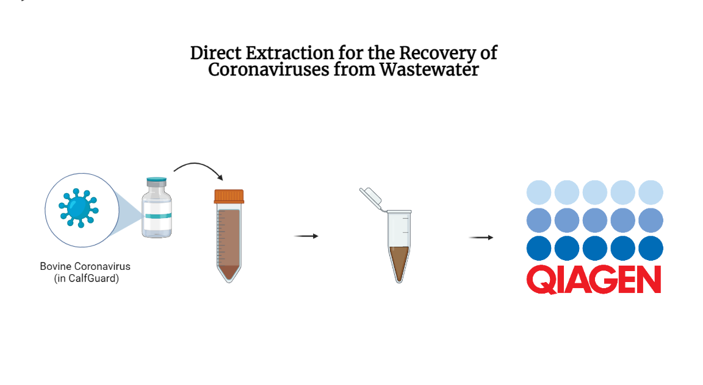

Slide 34
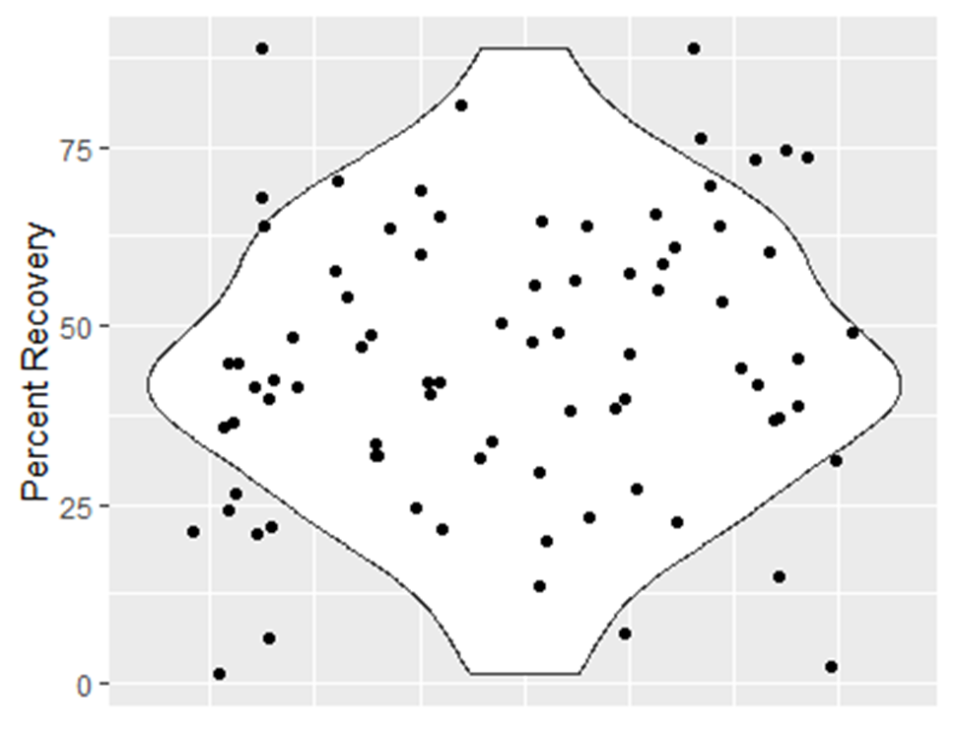
Average recovery from direct extraction is ~48%.
N = 81

Slide 35
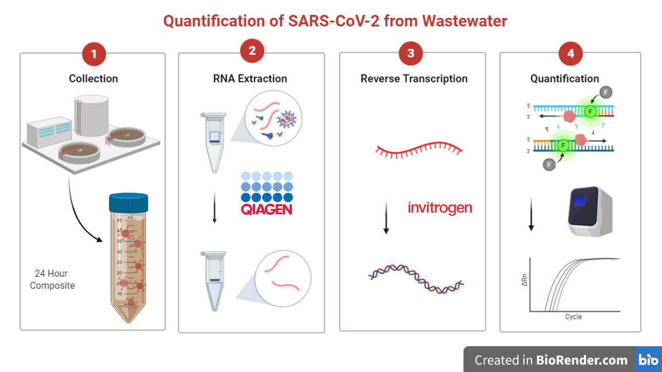

Slide 36
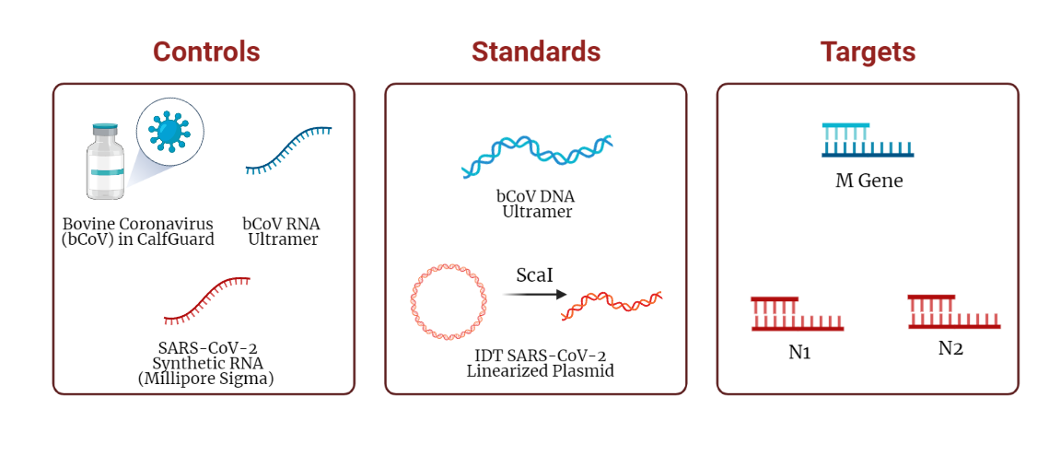

Slide 37
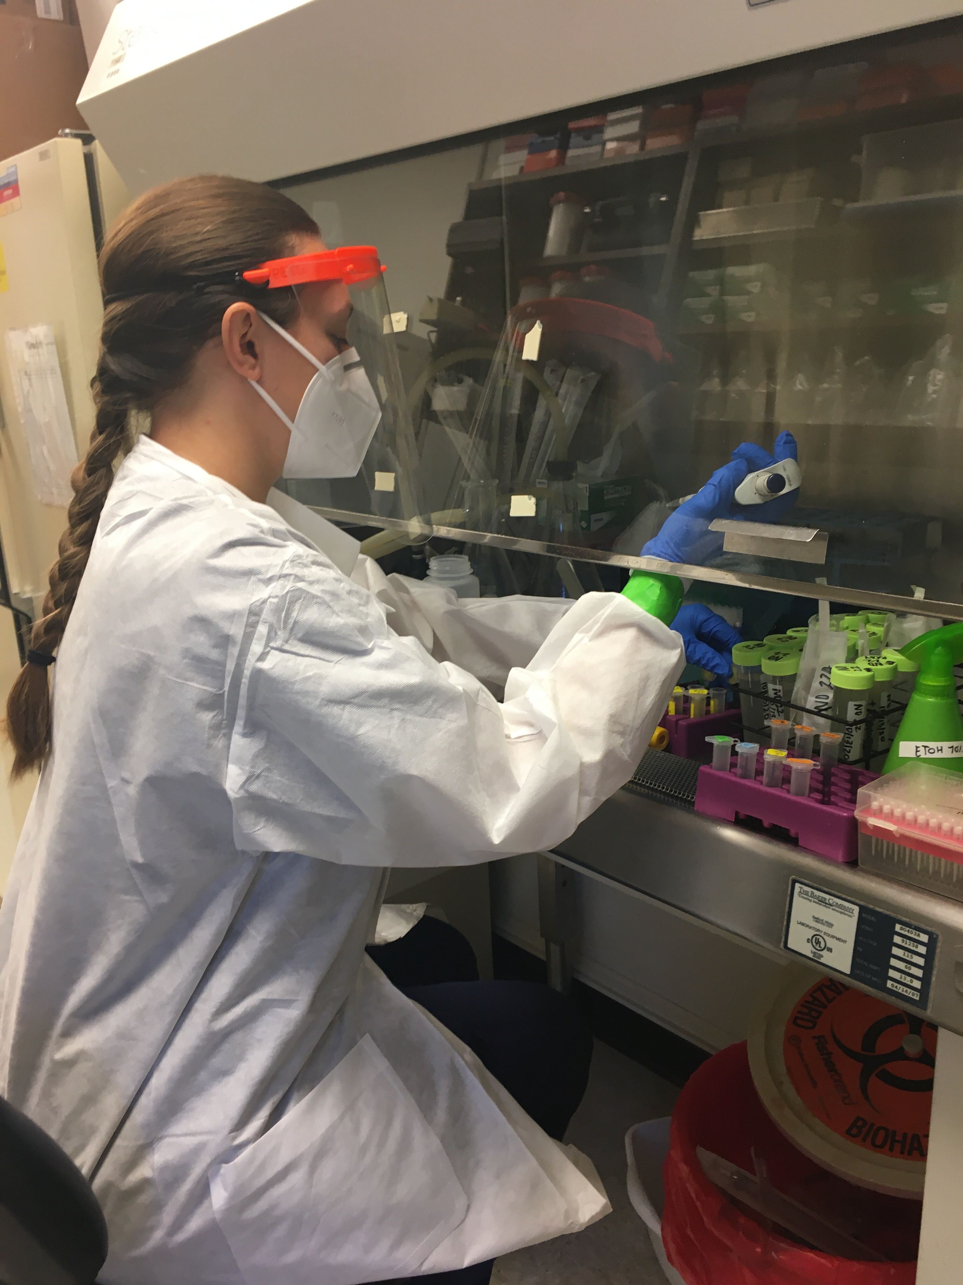

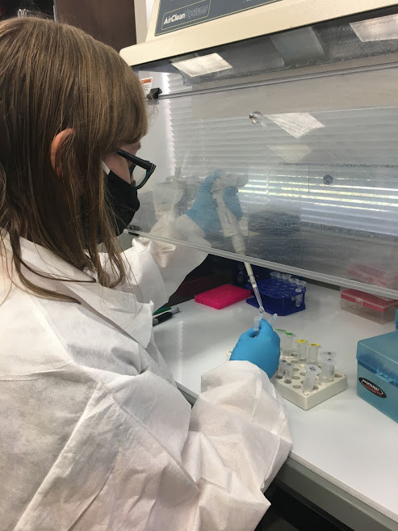
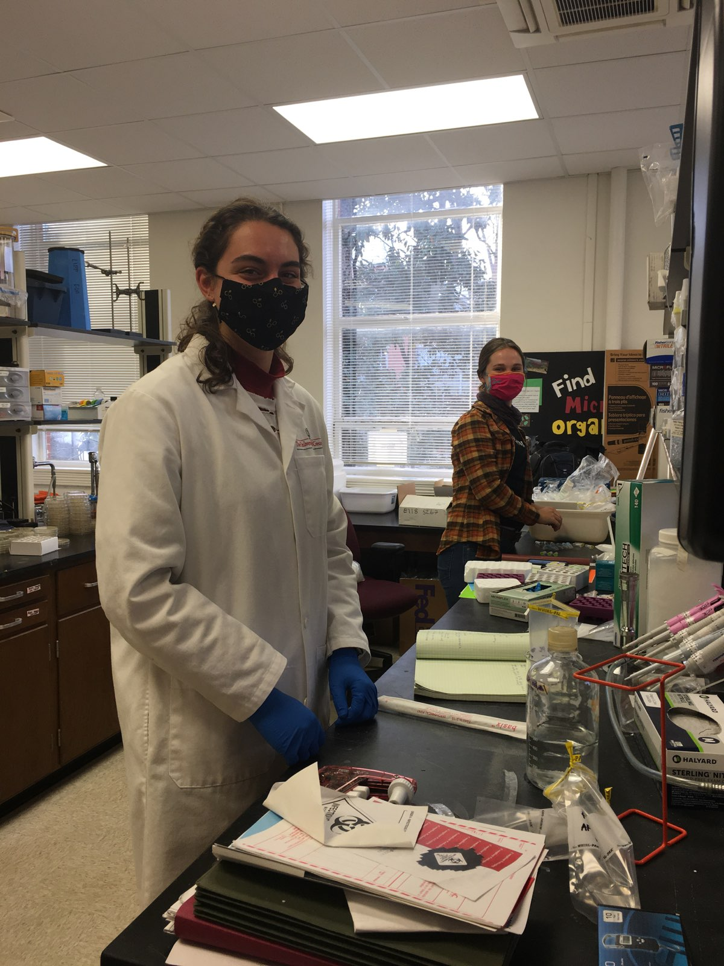

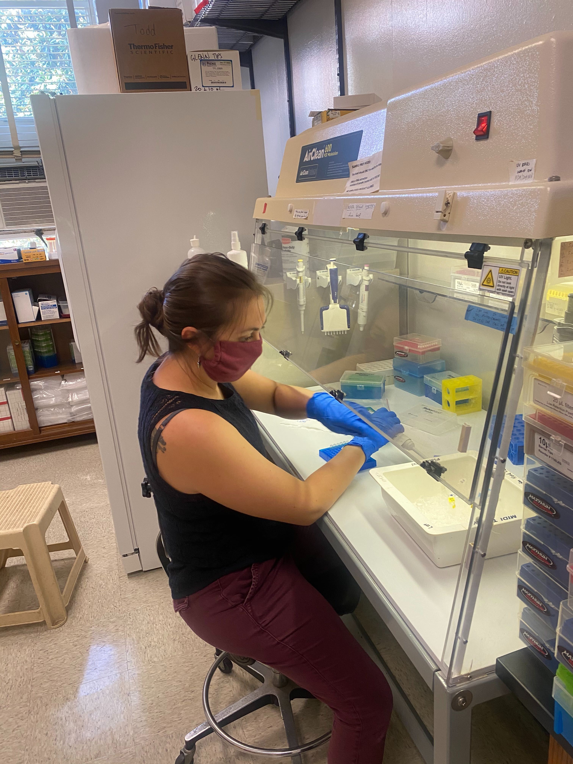

Slide 39
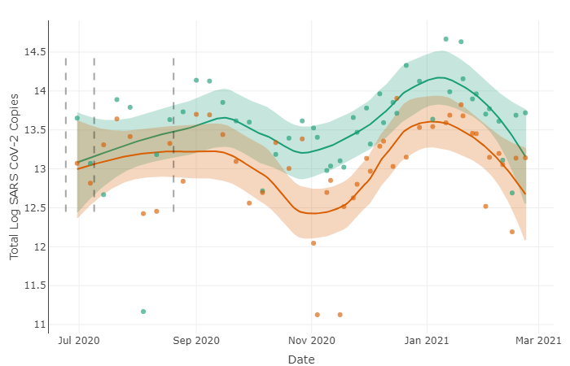
Total Viral Load of SARS-CoV-2 Viral RNA in Wastewater from Athens-Clarke County
N1
N2

Slide 40
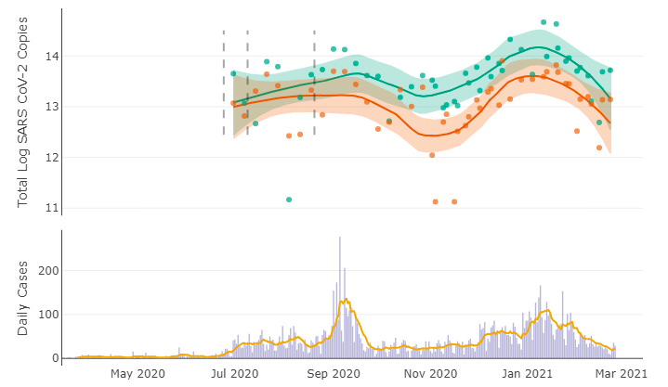
Total Viral Load of SARS-CoV-2 Viral RNA in Wastewater from Athens-Clarke County
N1
N2
Daily Cases
7-Day Avg

Slide 41
Total Viral Load of SARS-CoV-2 Viral RNA in Wastewater from Athens-Clarke County
N1
N2
Daily Cases
7-Day Avg

Slide 42
Total Viral Load of SARS-CoV-2 Viral RNA in Wastewater from Athens-Clarke County
N1
N2
Daily Cases
7-Day Avg

Slide 43
Total Viral Load of SARS-CoV-2 Viral RNA in Wastewater from Athens-Clarke County
N1
N2
Daily Cases
7-Day Avg

Slide 44
Total Viral Load of SARS-CoV-2 Viral RNA in Wastewater from Athens-Clarke County
N1
N2
Daily Cases
7-Day Avg

Slide 45
Total Viral Load of SARS-CoV-2 Viral RNA in Wastewater from Athens-Clarke County
N1
N2
Daily Cases
7-Day Avg

Slide 46
Total Viral Load of SARS-CoV-2 Viral RNA in Wastewater from Athens-Clarke County
N1
N2
Daily Cases
7-Day Avg

Slide 47
Total Viral Load of SARS-CoV-2 Viral RNA in Wastewater from Athens-Clarke County
N1
N2
Daily Cases
7-Day Avg

Slide 48
Total Viral Load of SARS-CoV-2 Viral RNA in Wastewater from Athens-Clarke County
N1
N2
Daily Cases
7-Day Avg

Slide 49
Total Viral Load of SARS-CoV-2 Viral RNA in Wastewater from Athens-Clarke County
N1
N2
Daily Cases
7-Day Avg

Slide 50
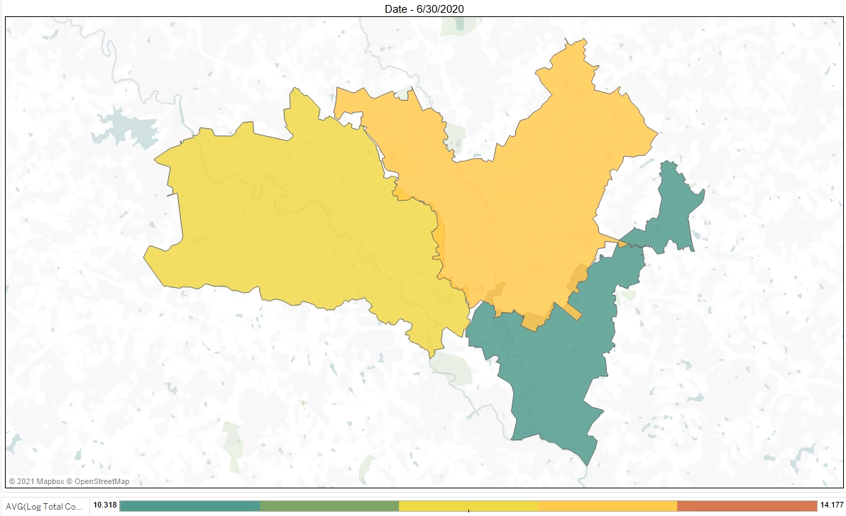

Slide 51
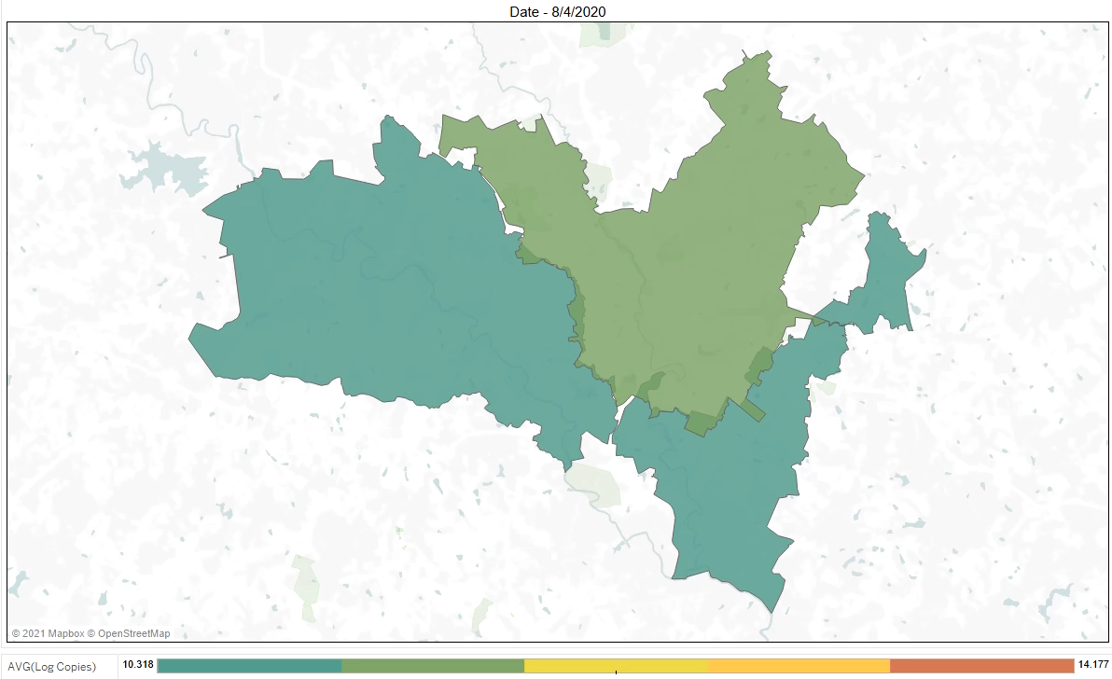

Slide 52

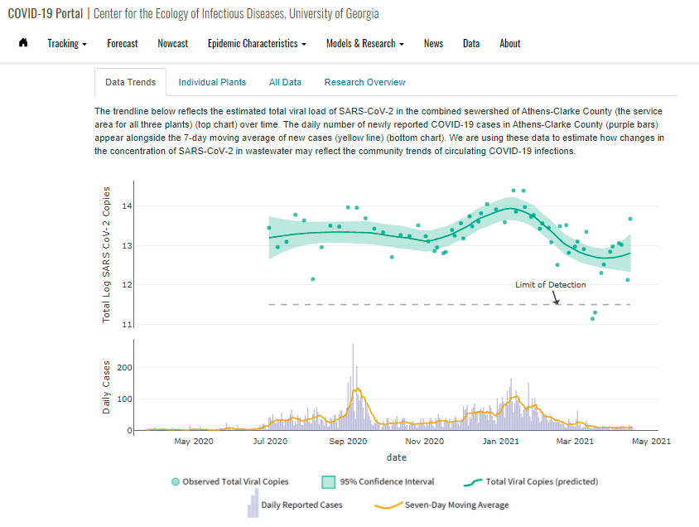
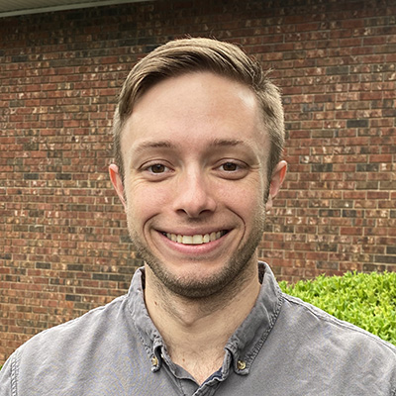
covid19.uga.edu/wastewater-athens

Slide 53
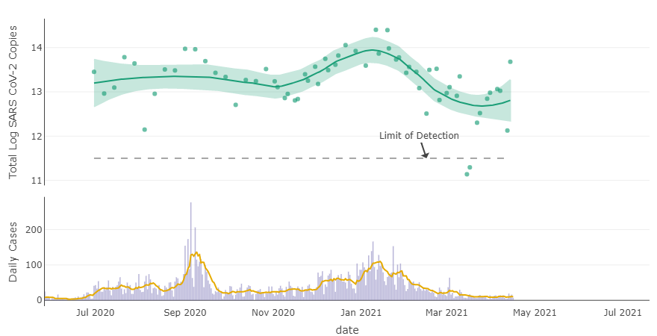
Total Viral Load of SARS-CoV-2 Viral RNA in Wastewater from Athens-Clarke County
N1-N2 Avg
LOESS Trend
Daily Cases
7-Day Avg

Slide 54
Website Updated Weekly!
June 30, 2020 – June 30, 2021

Slide 55
Successes & Challenges of Public Sharing

Slide 56
Successes
Responding in real-time to a public need
Especially critical when testing is low
Providing an additional layer of data & perspective

Slide 57
Challenges
Sharing data and interpretations with a lay audience
Publishing data before it is fully analyzed & peer-reviewed
Accountable for delays in data and reporting
We’re not great at making predictions

Slide 58
How well does the total viral load in wastewater correlate with the number of reported cases?

Slide 59

How well does the total viral load in wastewater correlate with the number of reported cases?

Slide 60
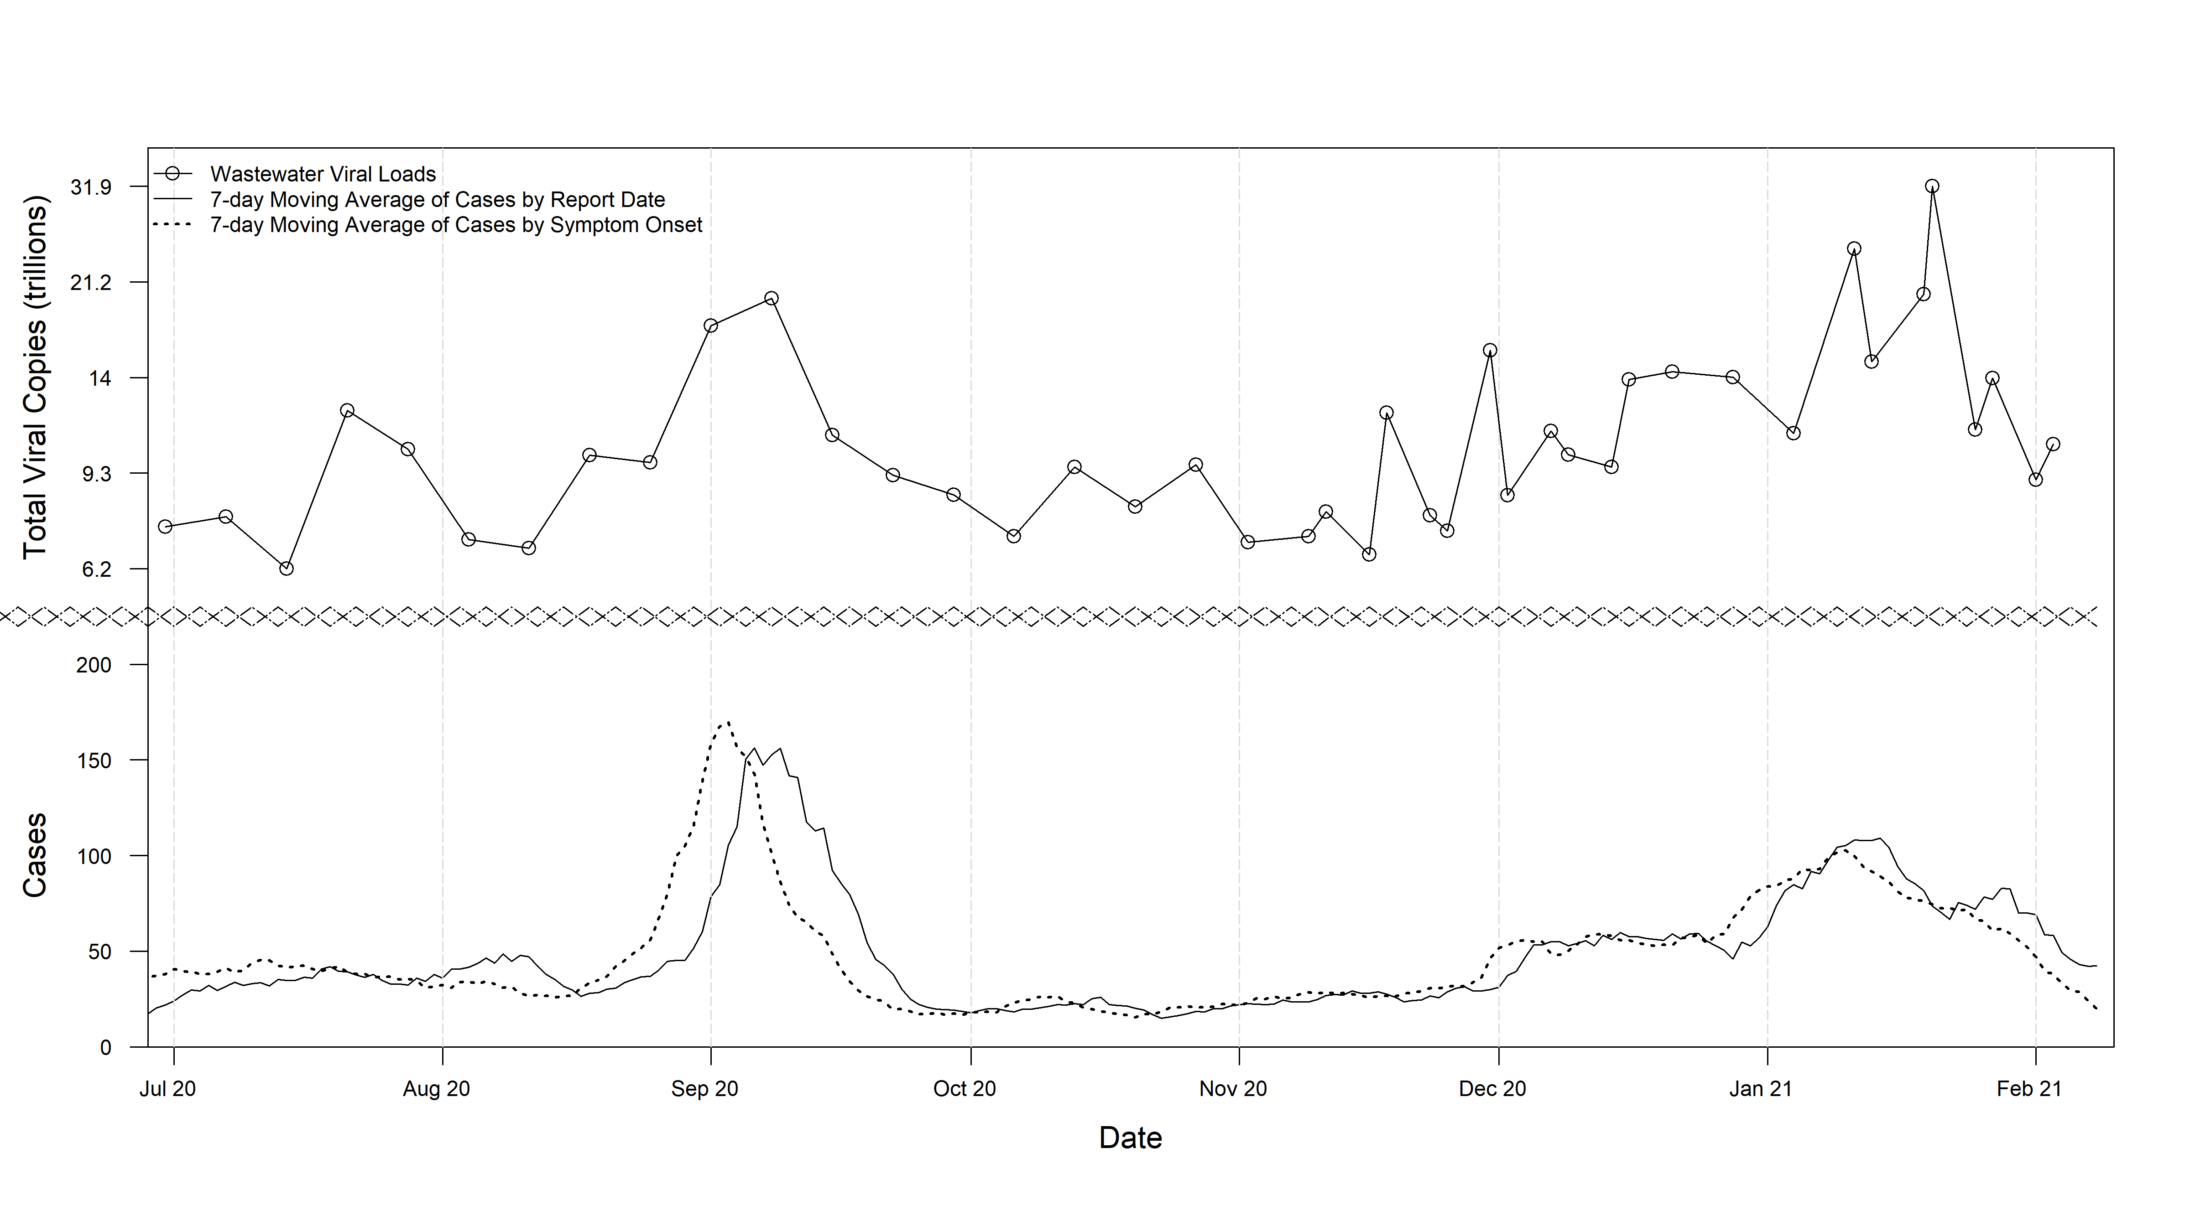

Slide 61
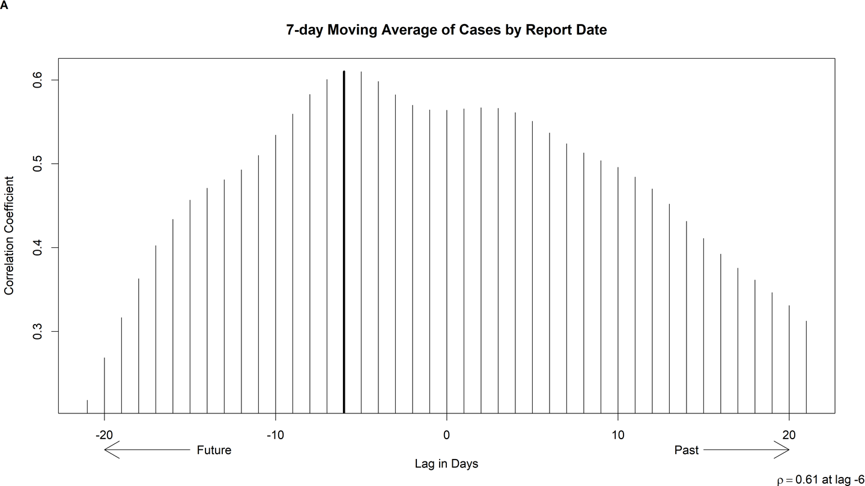
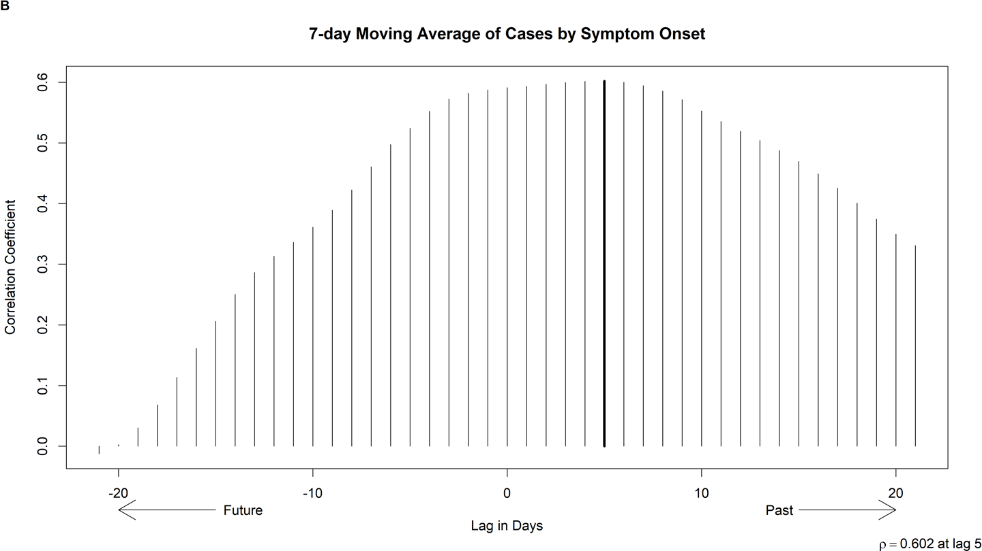
Viral load is most strongly correlated with:
5 day lag behind
reported symptoms
6 day lead ahead of
case reports & test results

Slide 62
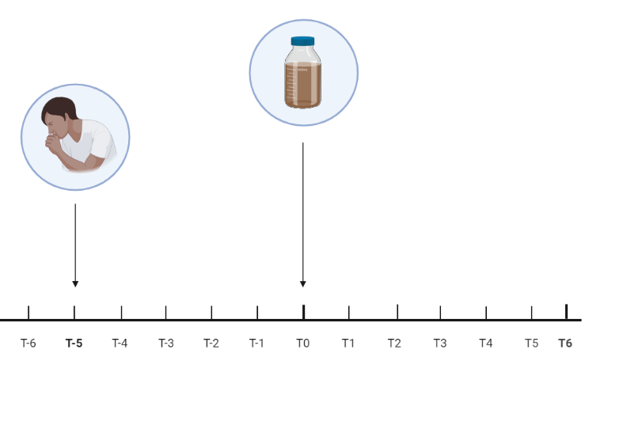
5 days, p = 0.602

Slide 63
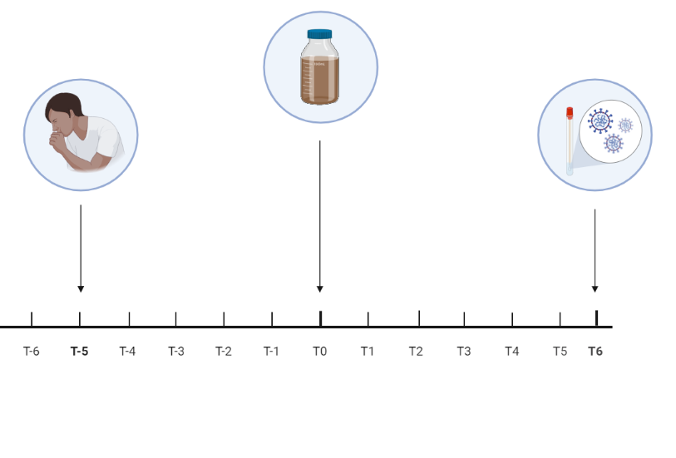
5 days, p = 0.602
6 days, p = 0.61

Slide 64
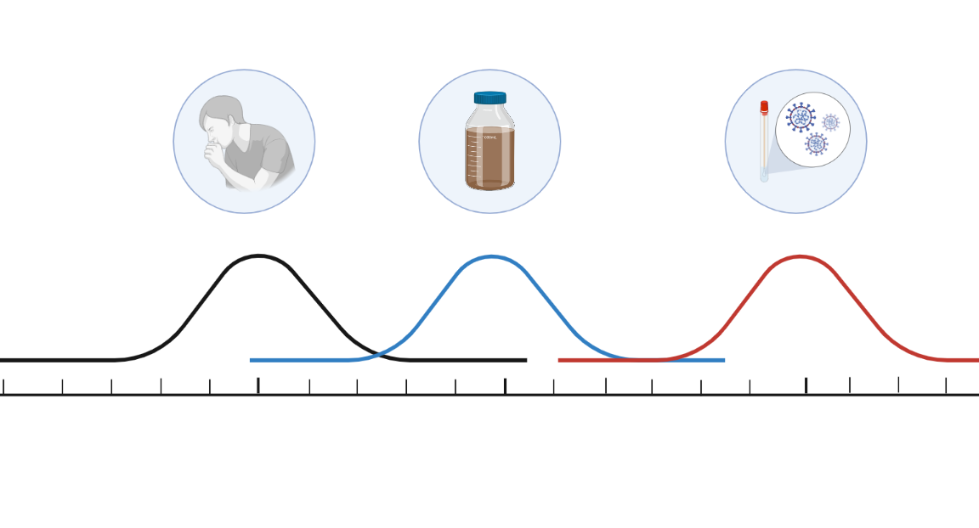

Slide 65

Predictive Modeling from
Total Viral Load in Wastewater

Slide 66
Wastewater-based Surveillance
for SARS-CoV-2

Slide 67
Research Questions
Can we apply wastewater-based surveillance for SARS-CoV-2 in Athens, GA?
Can we detect SARS-CoV-2 in wastewater with currently available methods?
How well do trends in viral loads in wastewater correlate with cases of COVID-19. Is wastewater a leading indicator to predict outbreaks?

Slide 68
Key Findings
We have been able to detect SARS-CoV-2 from wastewater in Athens, GA using direct extraction methods
Temporal trends in wastewater concentration of SARS-CoV-2 reflect trends in reported cases of COVID-19
There appears to be a 5-day lag behind reported symptoms, and a 6-day lead time ahead of reported cases
Differences in spatial-temporal trends between catchment areas may provide evidence for localized “hot zones”

Slide 69
Future Directions
Maintaining monitoring program throughout vaccine rollout
Interpretation and actionability of wastewater results
Detection, quantification, and sequencing of novel variants

Slide 70


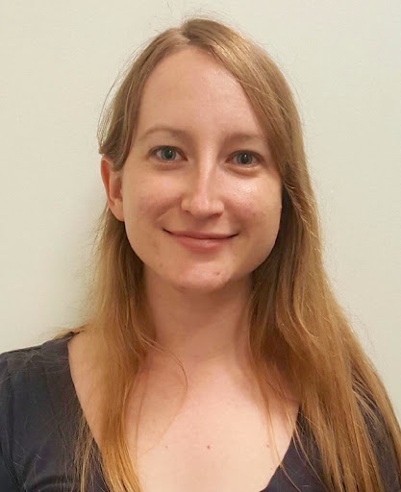
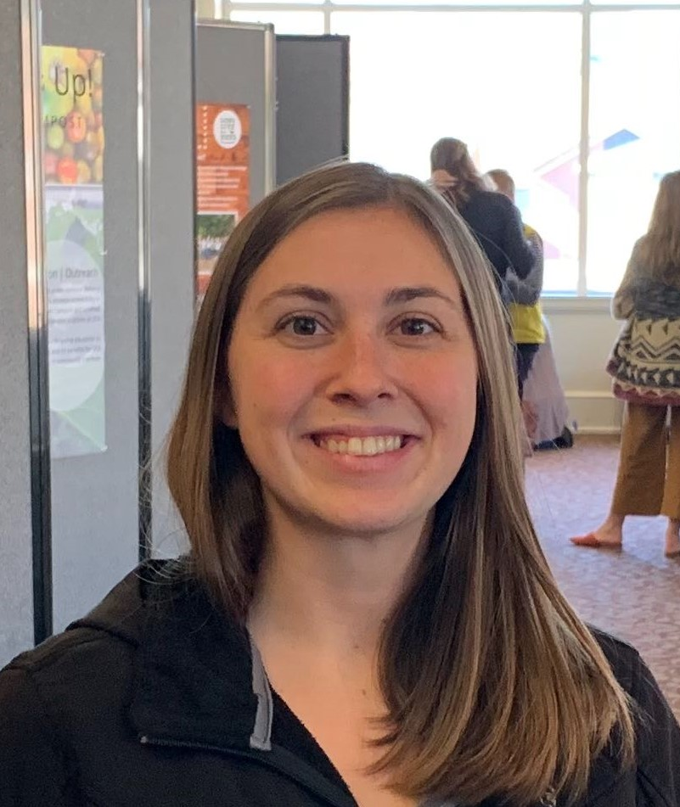
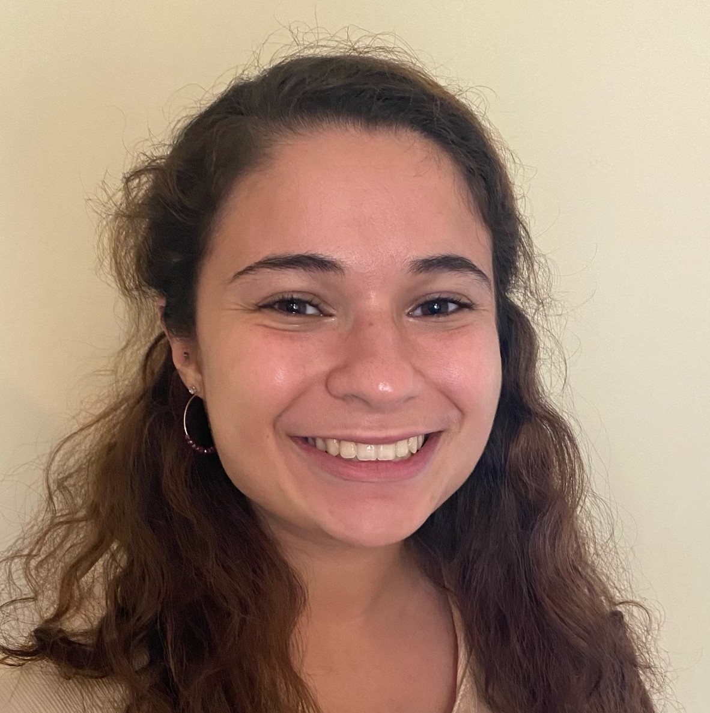






Dr. Erin Lipp
William Norfolk
Amelia Foley
Megan Robertson
Megan Lott
Cody Dailey
Carolina Melendez Declet
Taylor Maddalene

Slide 71
From Sea
The Lipp Lab
William Norfolk
Amelia Foley
Carolina Melendez Declet
Amanda Glatter
Megan Robertson
Honorary: Cody Dailey
Honorary: Taylor Maddalene
Honorary: Abigail Hobbs
Committee
Dr. Erin K. Lipp
Dr. Elizabeth Ottesen
Dr. Travis Glenn
Dr. Franklin Leach
EHS Department & Friends
Smithsonian Marine Station
To Sewer

Slide 72

The total viral load is correlated with the number of cases reported 6 days in the future.
There is a lead time of 6 days.

Slide 73
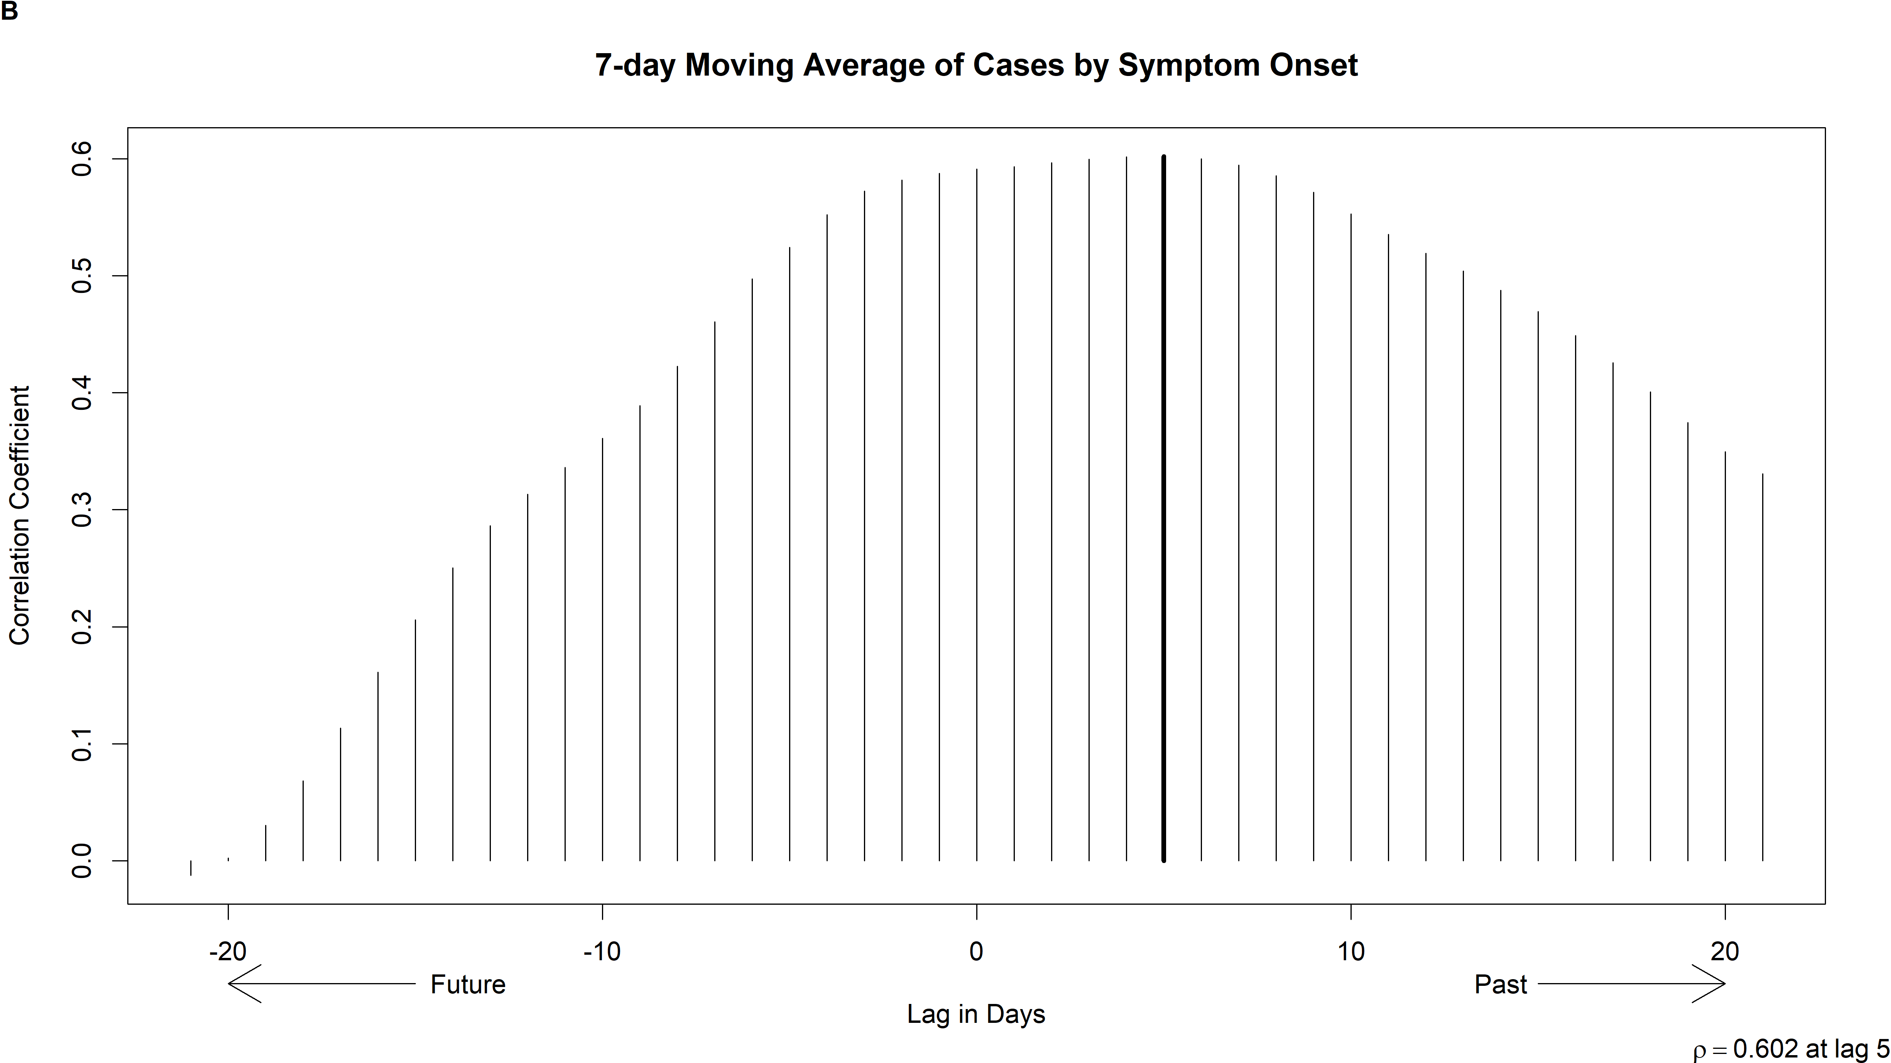
The total viral load lags behind the number of cases by symptom onset. This lag is ~ 5 days.

Slide 74
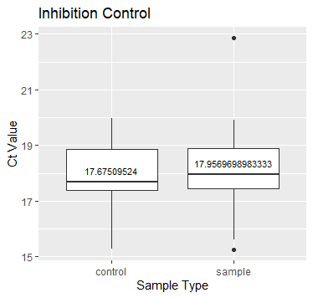

Slide 75
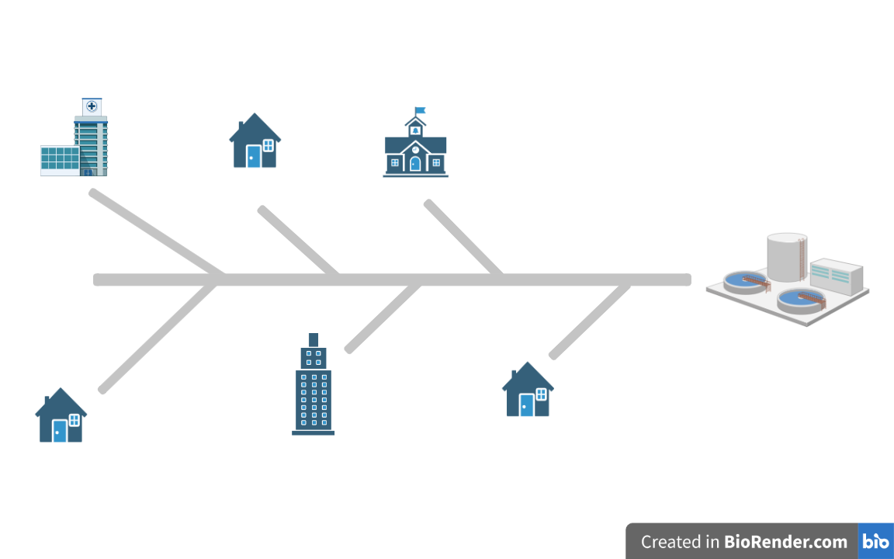
Sewer Line Surveillance

Slide 76
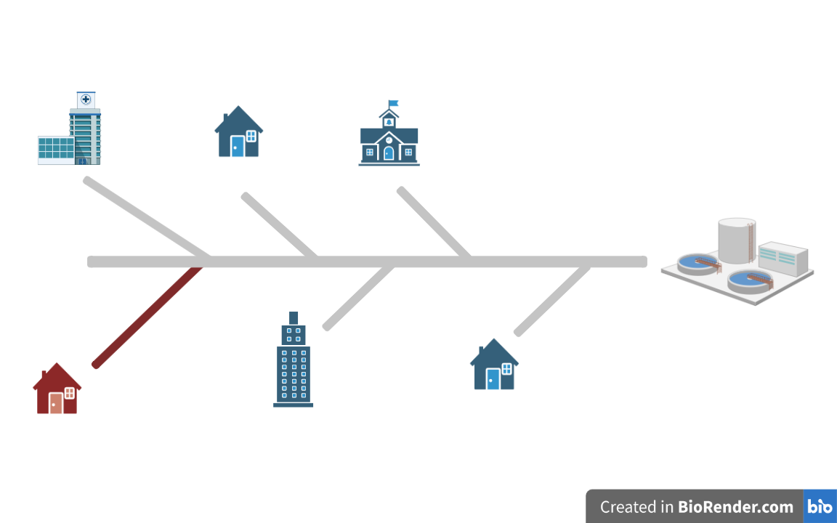
Sewer Line Surveillance

